Slide 1

Impact of NBA Team Performance on Fan Engagement
Tomer Zur
Notes:
https://cdn.freebiesupply.com/images/large/2x/nba-logo-transparent.png

Slide 2
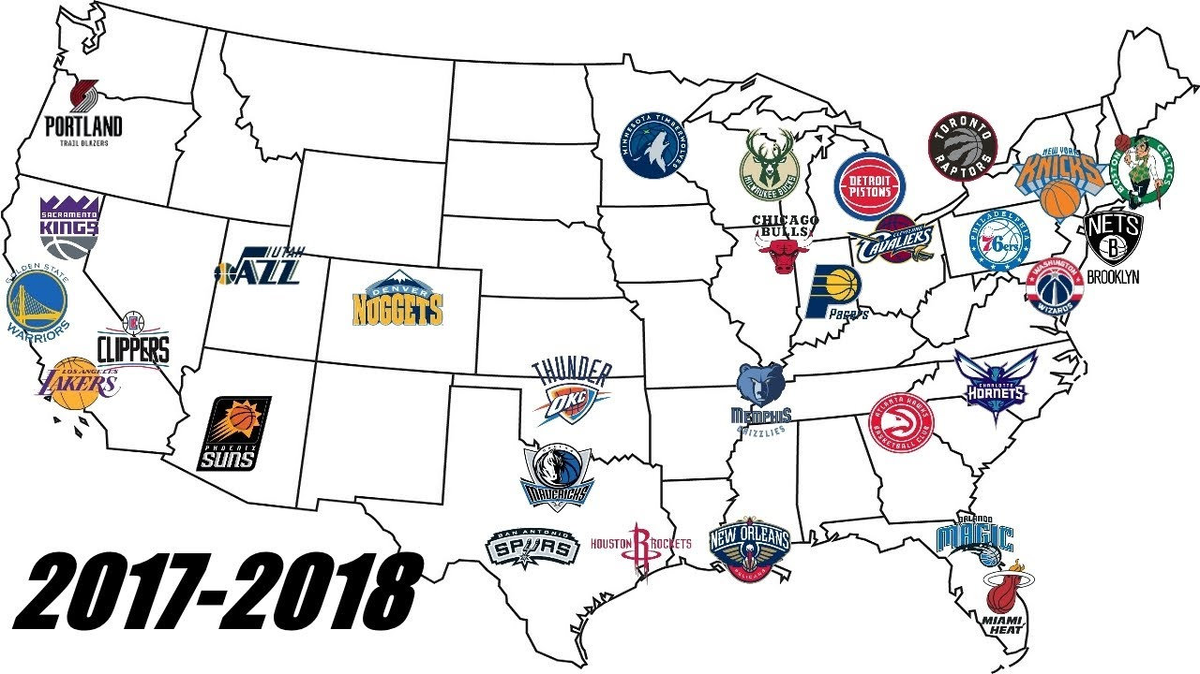
Introduction
We are seeing how NBA teams winning/losing impacts the NBA’s brand image and consumption
We have localized Harris Brand Platform data and are comparing it to local NBA teams’ performance to see how much the team’s performance impacts the NBA brand image
We are also comparing this to passive behavioral data to see how team performance impacts the NBA’s engagement/consumption metrics
We will also look at these metrics over time to see how different events (such as the playoffs and the offseason) impact them.
Notes:
https://i.ytimg.com/vi/0Px6S-G5WFY/maxresdefault.jpg

Slide 3



Data
Brand Health (Harris Brand Platform - ongoing brand tracker)
April 2021-October 2022
16,179 total NBA respondents – 9,257 respondents that we could match up to an NBA team
purchase consideration, reputation, % promoter, % willing to pay premium
Large Device Engagement (Samba TV snapshot of US TV audience)
April 2021-October 2022
>2 million respondents per month
NBA games/tv shows watched
Small Device Engagement (panel of users whose PC and phone/tablet usage is tracked)
September 2021-August 2022
5,489 total users with NBA data
NBA app/website usage, YouTube views, search events
Notes:
https://www.nist.gov/sites/default/files/images/2022/03/29/Survey.png
https://cdn-icons-png.flaticon.com/512/3260/3260248.png
https://cdn-icons-png.flaticon.com/512/0/191.png

Slide 4
Analyses
Time Series
NBA team performance
Samba data (games/TV shows watched)
Luth data (app/website usage, YouTube views, search events)
Harris Brand Platform data (purchase consideration, reputation, % promoter, % willing to pay premium)
Correlations
How much does winning impact key consumer metrics?
I used the DMA code (for Samba and Harris Brand Platform data) or state (Luth data) to derive the home team for each respondent
If there were multiple NBA teams located near that DMA or state, I marked the home team as Unsure
If there were no NBA teams located near that DMA or state, I marked the home team as No Team

Slide 5
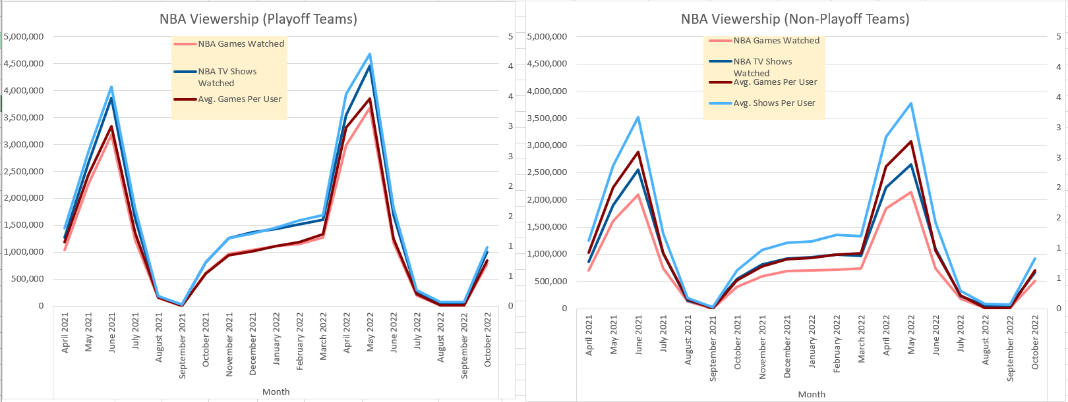
Time Series Analyses
Playoff Teams have more viewers (both games and shows) than non-playoff teams

Slide 6
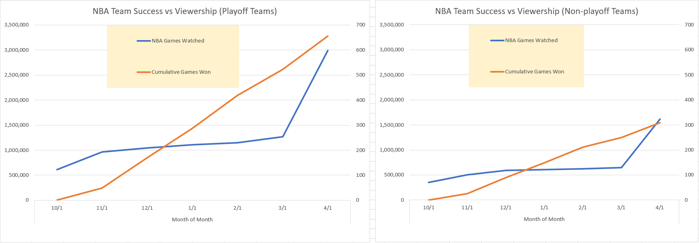
Time Series Analysis
We also put team performance and viewership on the same axes:
The better teams attract more viewership than the worse teams

Slide 7
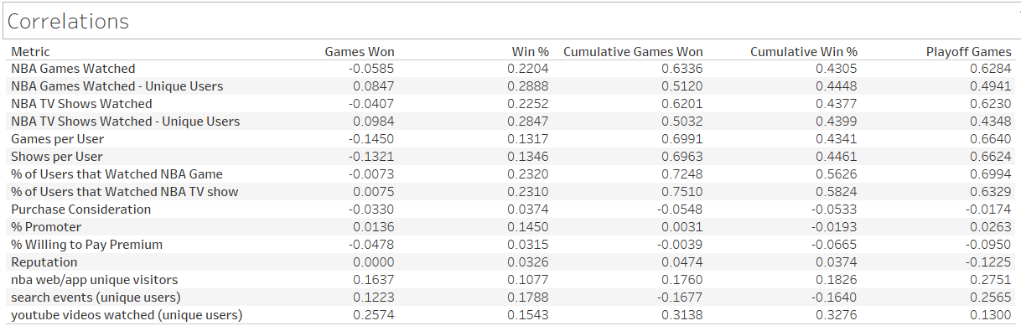
Correlations
A lot of metrics aren’t correlated, but some team performance metrics (especially the cumulative ones) show strong correlations with engagement metrics

Slide 8
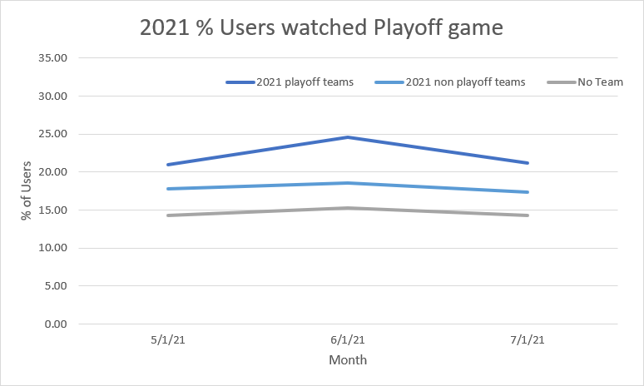
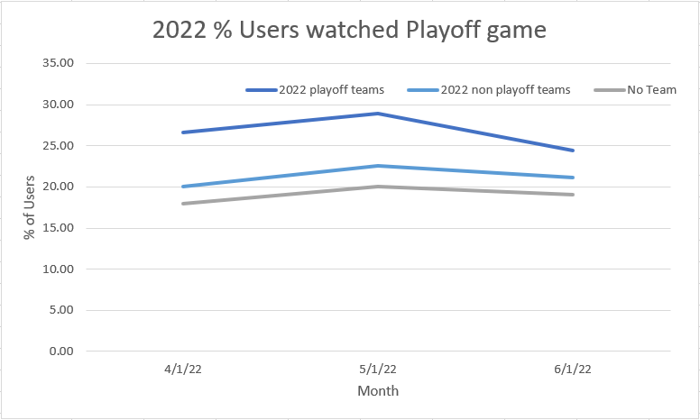
Takeaway
Playoff Teams have a little more viewership in the playoffs than non-playoff teams
But both playoff and non-playoff team areas get more viewership than areas with no NBA team
2021 playoffs: 24.54% of users from areas with playoff teams watched in June vs 18.61% of users from areas with non-playoff teams
15.28% of users with no home team watched
2022 playoffs: 28.88% of uses from areas with playoff teams watched in May vs 22.56% of users from areas with non-playoff teams
20.05% of users with no home team watched

Slide 9
Takeaway
The better the local team is, the more users from that area watch games
Correlation between cumulative games won and % of users that watched NBA game is 72.48%
Correlation between cumulative win % and % of users that watched NBA game is 56.26%
Correlation between playoff games and % of users that watched NBA game is 69.94%
However, just being good for one month is not enough to change viewership too much:
Correlation between games won (in a month) and % of users that watched NBA game is -0.73%
Correlation between win % and % of users that watched NBA game is 23.20%
Correlations
 | Games Won | Win % | Cumulative Games Won | Cumulative Win % | Playoff Games Played
% of users that watched NBA game | -.0073 | .2320 | .7248 | .5626 | .6994

Slide 10
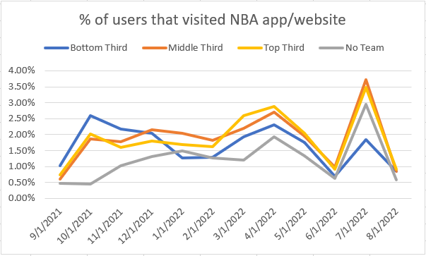
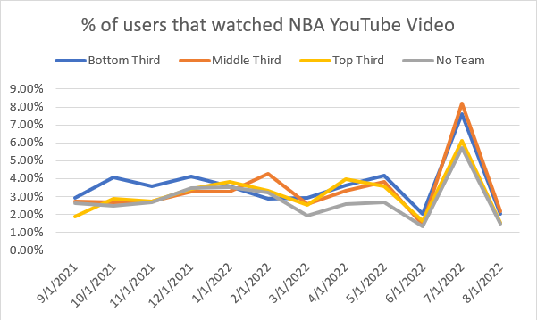
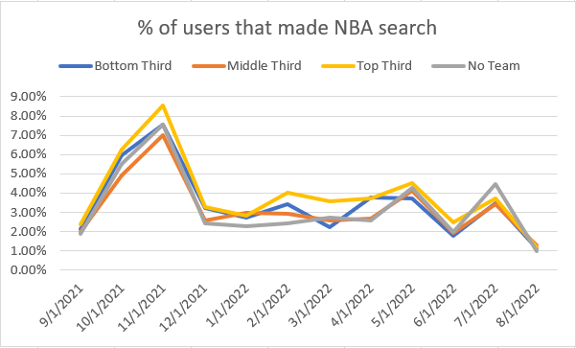
Takeaway
The better the local team is, the (slightly) more mobile/web interaction takes place
After grouping the top, middle, and bottom performing teams together each month, we find correlations of:
41.64% between cumulative win % and NBA website/app unique visitors
56.99% between cumulative win % and NBA YouTube videos watched (by unique users)
18.58% between cumulative win % and NBA searches (by unique users)
These correlations are not very noticeable when looking at the graphs of each of these metrics
Notes:
https://cdn-icons-png.flaticon.com/512/0/191.png

Slide 11
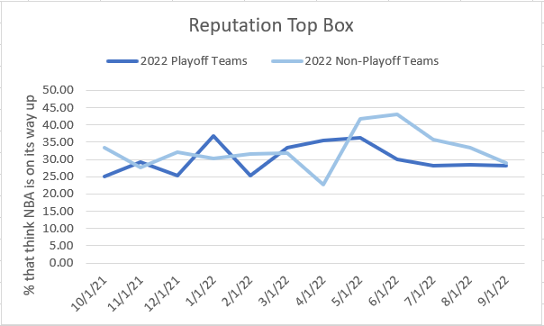
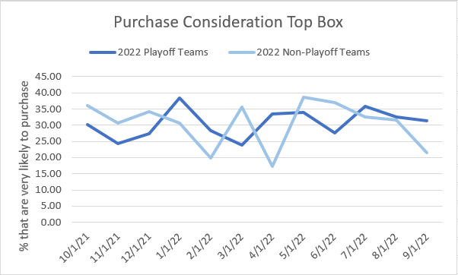
Takeaway
Overall NBA approval/reputation is resistant to current performance of local team
Harris Brand Platform metrics (% promoter, % willing to pay premium, reputation, purchase consideration) resistant to performance of local team
Ex. – Reputation (top box) among non-playoff teams: 22-43%, Reputation among playoff teams: 25-37%
Purchase consideration (top box) among non-playoff teams: 17-38%, Purchase consideration among playoff teams: 24-38%
Correlations between team performance metrics and Harris Brand Platform metrics are all low (0-15%)
For both regular season team performance and playoff team performance

Slide 12
Conclusion
In the end, being a better team helps increase local viewership, but it does not make a big impact on the league’s overall approval metrics.
NBA expansion to other cities will increase overall league viewership in those cities – the league should make an effort to do so
Next steps:
Running this analysis using each team’s approval metrics to see how resistant those are to the team’s performance (brand track by franchise)
Seeing how many people watched each team instead of seeing how many local fans watched the NBA

